Slide 1
Predictive analysis of YouTube trending videos using Machine Learning

Slide 2
Introduction
This purpose of the project is to assist if you are:
a) A youtuber who wants to make trending videos
b) An advertiser who wants to know the best video to put advertisements on before they become trending video
There will be some studies of the followings:
a) To perform analysis on correlation between features to determine how interactive video features helps a video trend on YouTube? is having a large number of views required for a video to trend? how important is the Correlation between features?
b) To compare analysis of ML classifiers for predicting YouTube trending video to determine which classifier is best suited for forecasting.

Slide 3
Data Size and description
36355
36355
The dataset is obtained from Kaggle Source.
Data size : 36,355 rows, 16 columns
Countries: UK, CA, USA
Time scope: 2020-07-27 to 2022-02-17

Slide 4
Data Cleaning and Text processing
Dataset
Null value
Remove duplicates video id
Text of titles
Make text lowercase
Remove text in square brackets,remove punctuation,extra space and remove words containing numbers.
stopwords.words('english’)
Tokenize the text

Slide 5

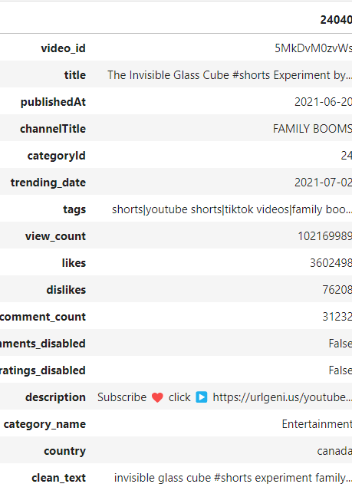
Exploratory data analysis
Maximum view count of a trending video
Notes:
As we can see, we have the ID of the video which is a unique value for the video across YouTube (No two videos have the same ID). We also have the title of the video, its publishing date and time, the channel that published it, its category, and its description and tags. We also have the number of the views, likes, dislikes, and comments of the video. There are also a few more data shown in the table.
The Trending Video with the Highest Number of Views is video called “The Invisible Glass Cube” under Entertainment category. The video was published on 2021-07-02, it appeared on the trending list with 102,169,989 views.

Slide 6
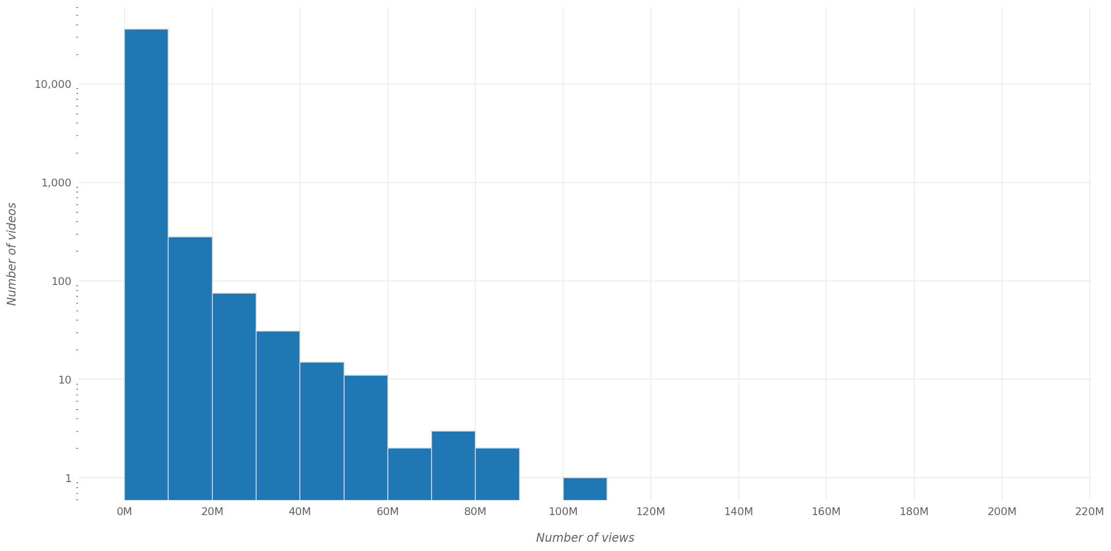
Exploratory data analysis
View-count distribution
Notes:
We can see that the vast majority of trending videos had less than 20 million views when they became trending. In fact, when they became trending, around 94% of trending videos had less than 10 million views and around 99.9% had less than 100 million views.

Slide 7
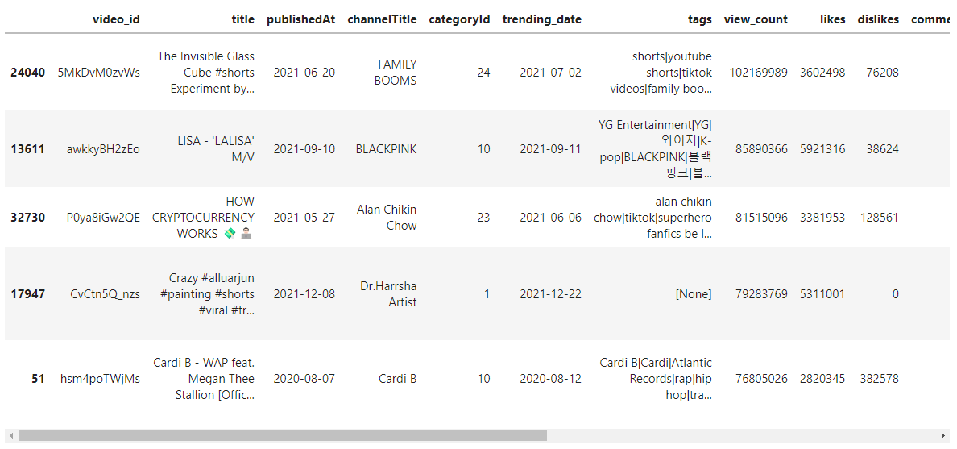
Exploratory data analysis
Trending videos with most views

Slide 8
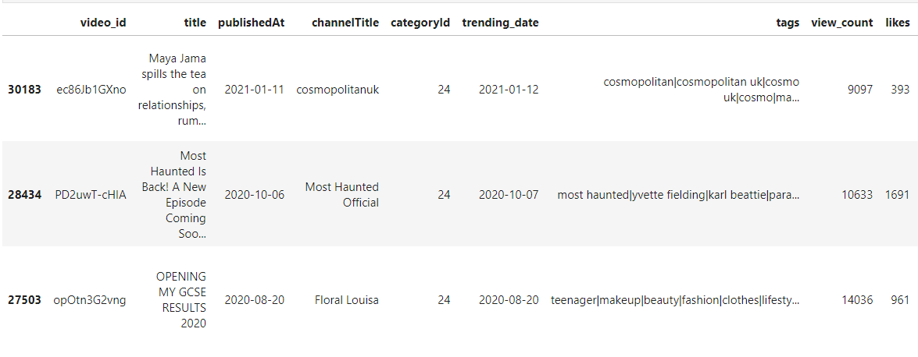
Exploratory data analysis
Trending videos with least views

Slide 9
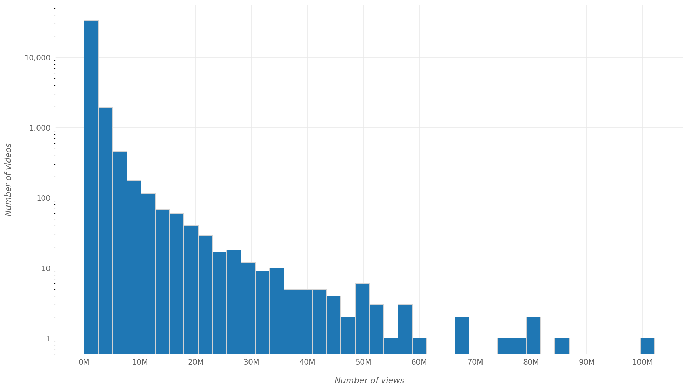
Exploratory data analysis
How many views a video has when first appearing on the trending list?

Slide 10
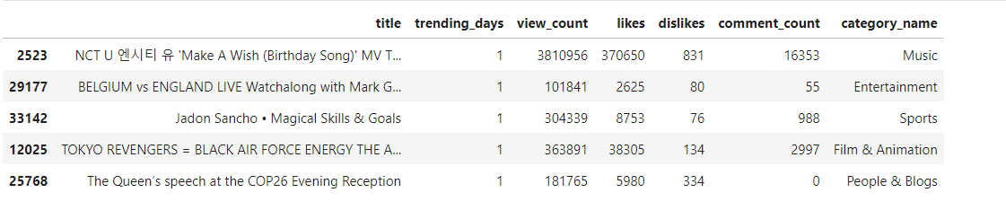
Exploratory data analysis
Trending for 30 Days

Slide 11
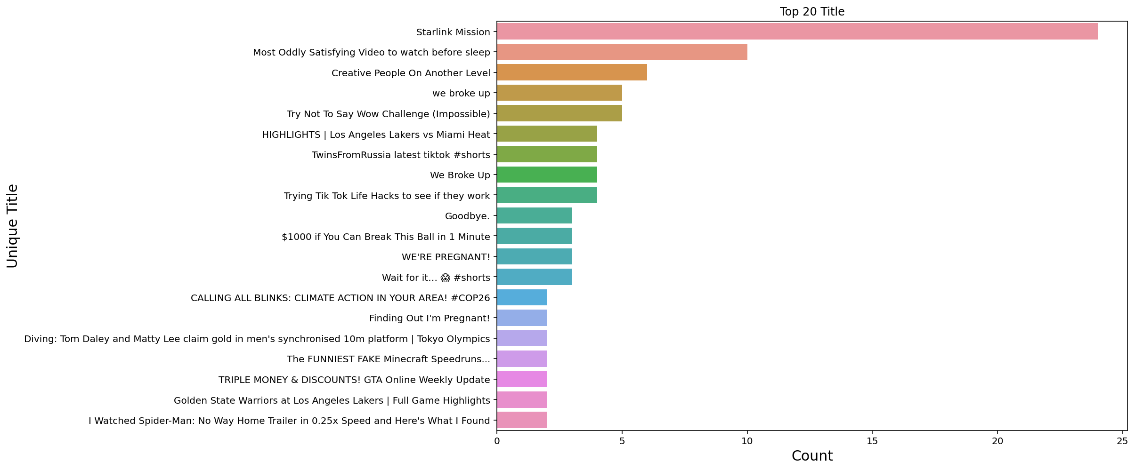
Exploratory data analysis
Trending Videos Titles

Slide 12
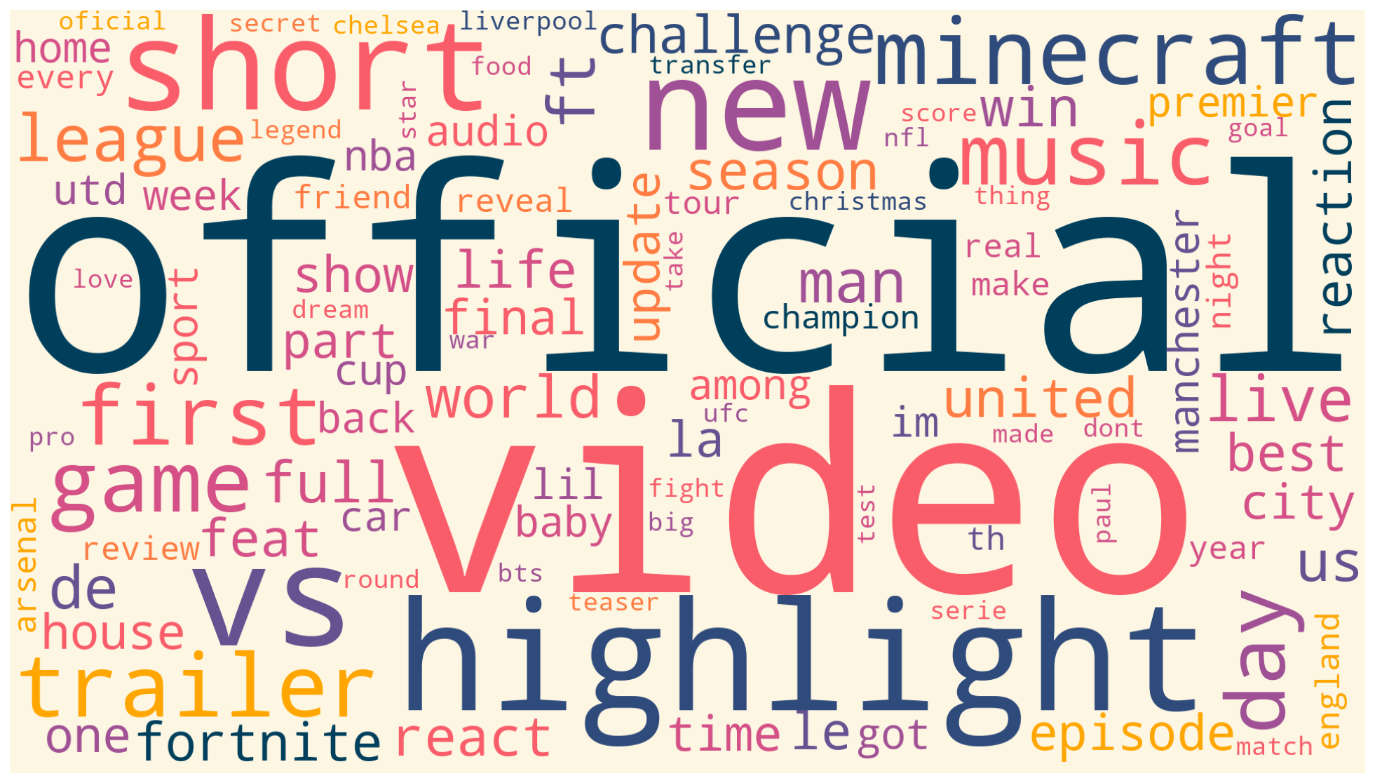
Exploratory data analysis
Most common words in video titles

Slide 13

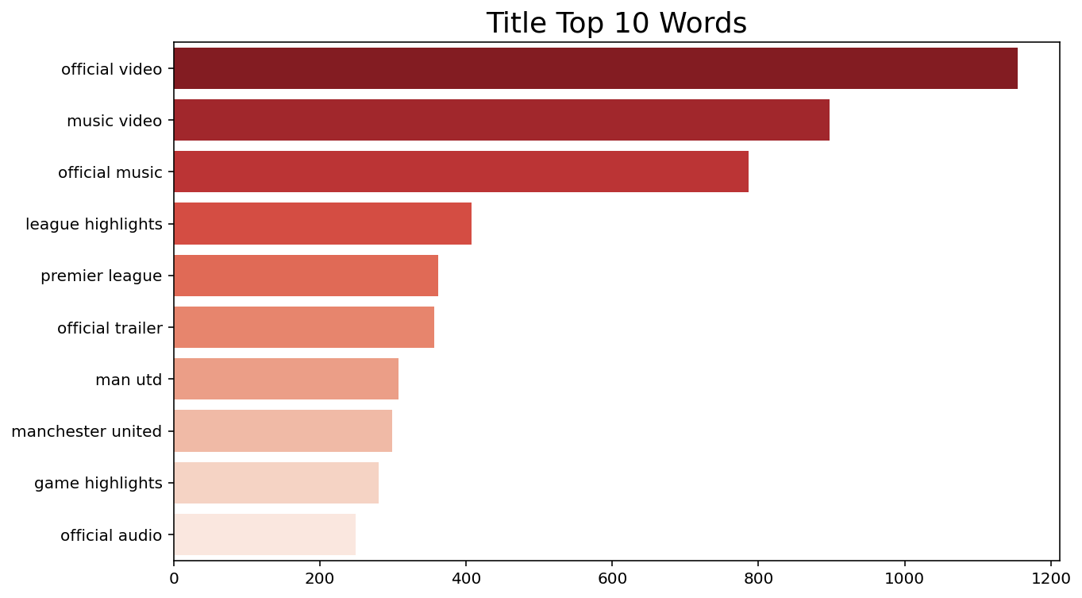
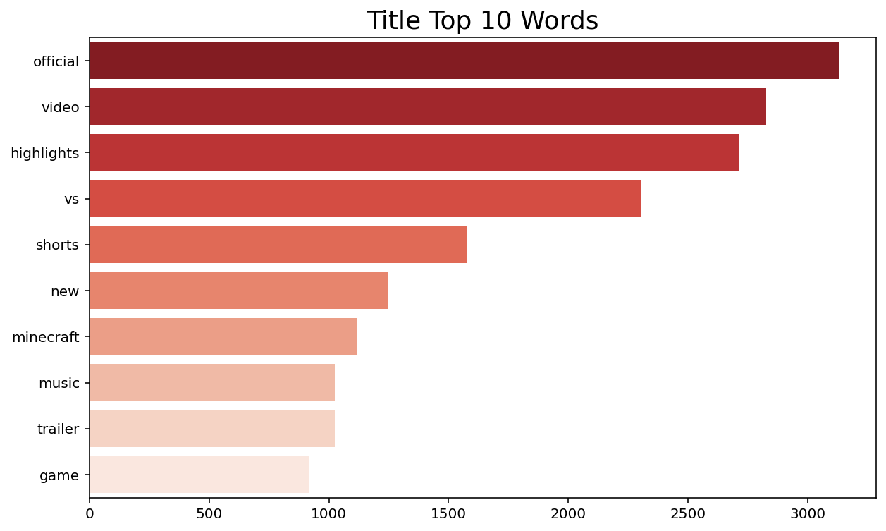
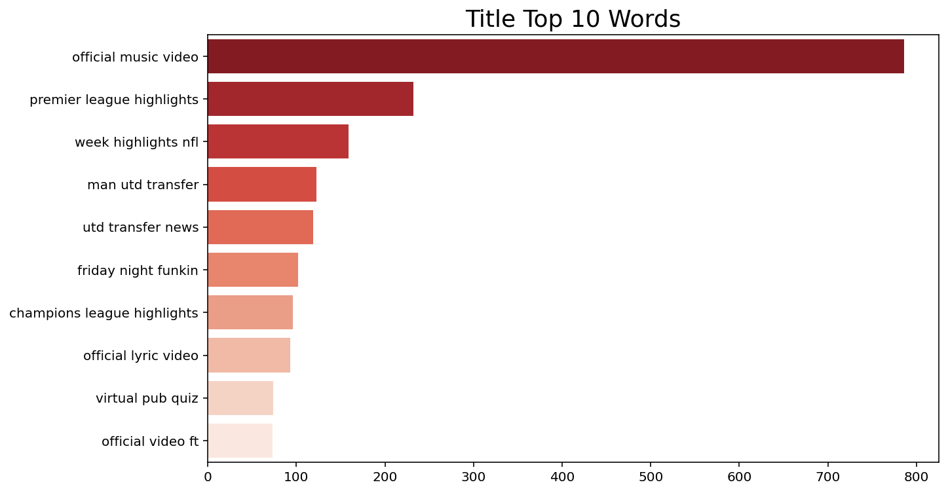
Exploratory data analysis
Most common word in video titles – Unigram/Bigram/Trigram

Slide 14
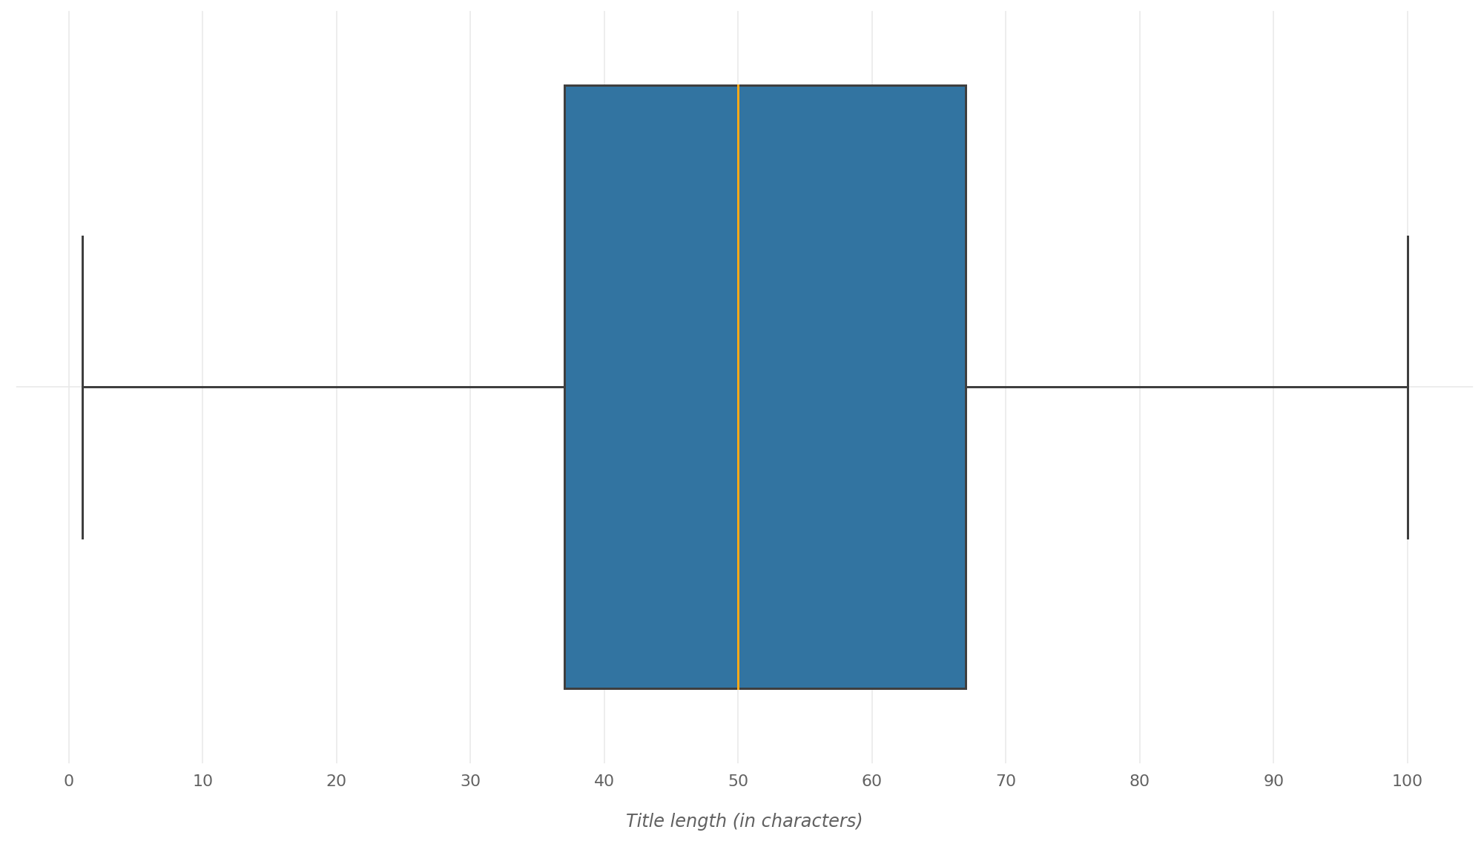
Exploratory data analysis
Distribution of title lengths

Slide 15
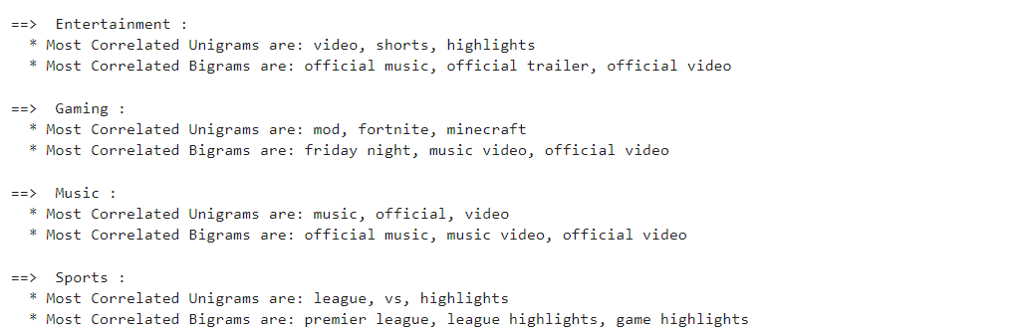
Exploratory data analysis
Most Correlated
Most Correlated Unigrams/Bigram/Trigram/

Slide 16
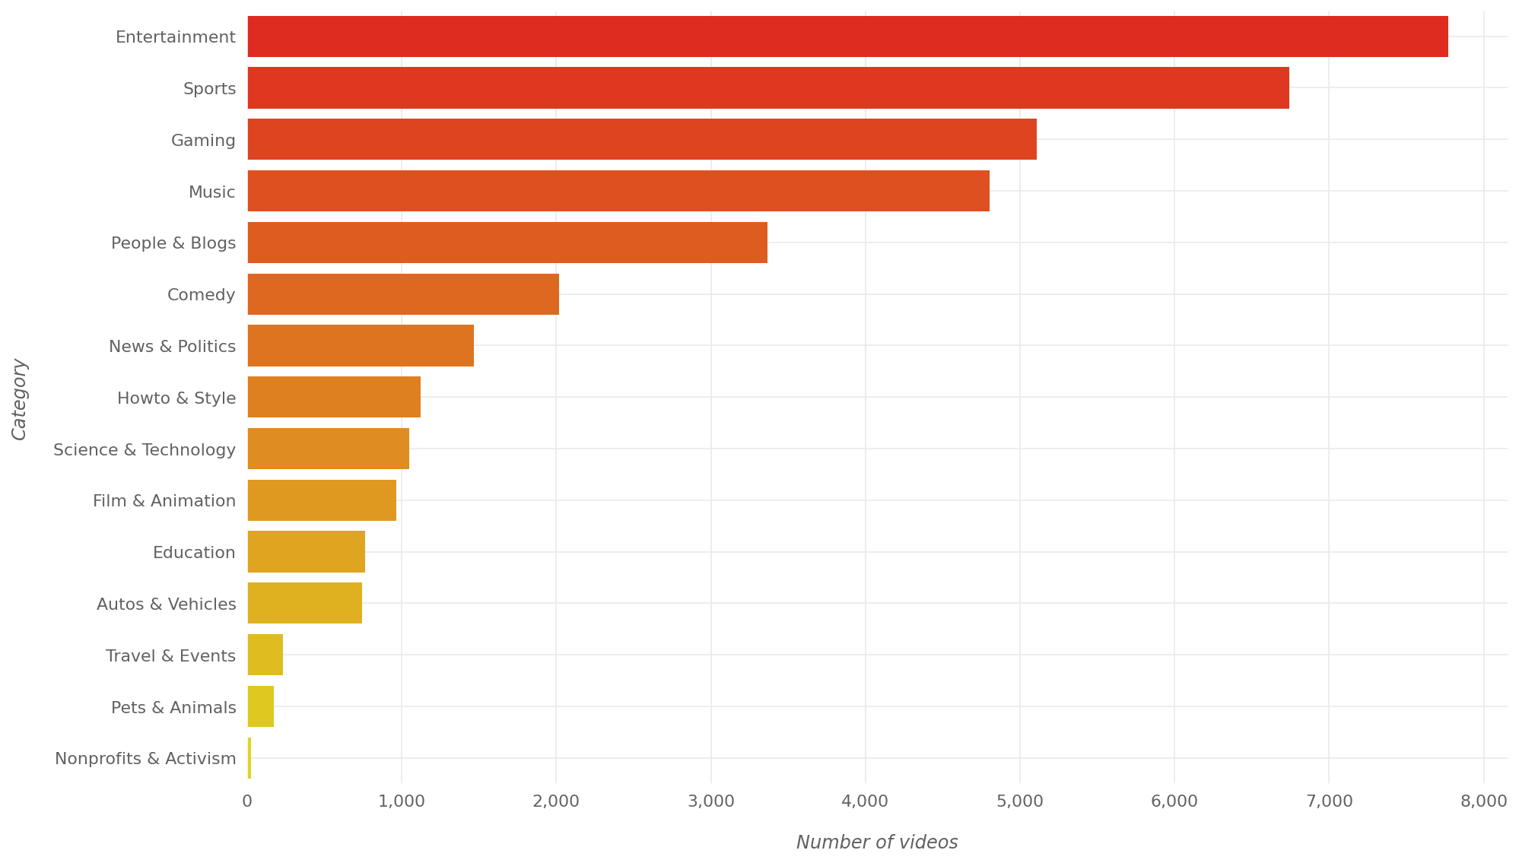
Exploratory data analysis
Top Categories of Trending Videos

Slide 17
Modelling
Predict y
Multiclass categories: Entertainment, Sport, Gaming, Music
Feature X
Title of video
Vectorizer selection
TfidfVectorizer (sublinear_tf=True, min_df=100,
ngram_range=(1, 2),
stop_words='english’)
- 187 features
Train test split

Slide 18
Modelling
models = [
RandomForestClassifier(n_estimators=100, max_depth=5, random_state=0),
MultinomialNB(),
BernoulliNB(),
DecisionTreeClassifier(random_state=0),
LogisticRegression(random_state=0),
GaussianNB(),
KNeighborsClassifier(n_neighbors=3)
]
CV = 5

Slide 19
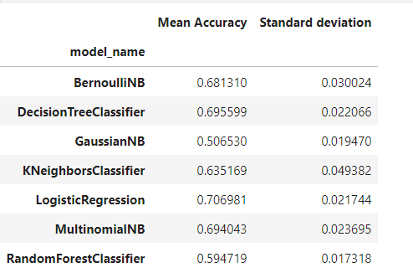
Modelling
Results

Slide 20
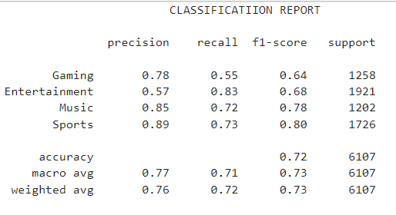
Modelling
Classification report - LogisticRegression

Slide 21
Modelling
Classification report – LogisticRegression
Accuracy: 0.7219

Slide 22
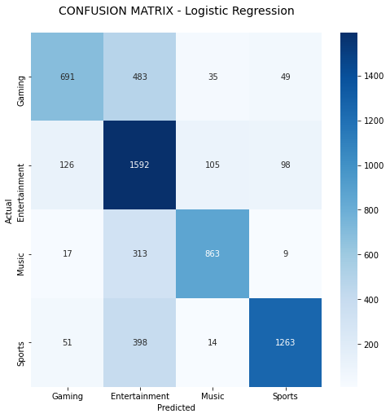
Modelling

Slide 23
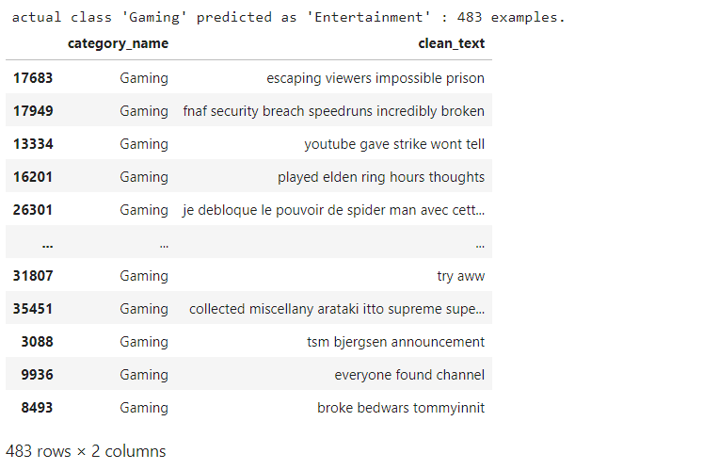
Modelling

Slide 24
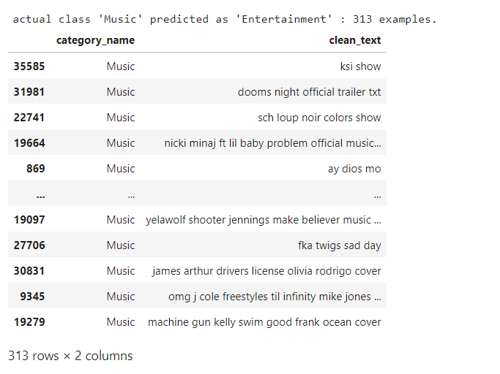
Modelling

Slide 25
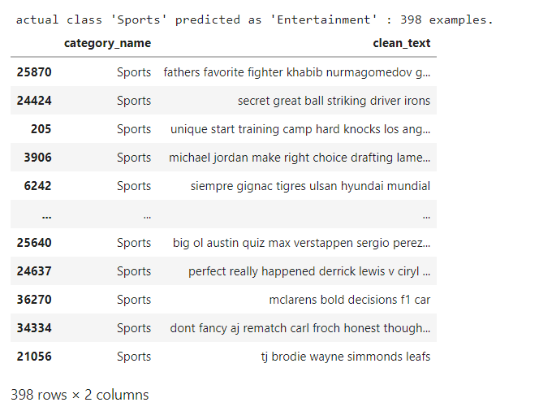
Modelling

Slide 26
Modelling
Implementing Gridsearch CV
param_grid = [
{'classifier' : [LogisticRegression()],
'classifier__penalty' : ['l1', 'l2'],
'classifier__C' : np.logspace(-10, 10, 100),
'classifier__solver' : ['liblinear']},
{'classifier' : [LogisticRegression()],}
]
clf = GridSearchCV(pipe, param_grid = param_grid, cv = 10, verbose=True, n_jobs=-1)
Accuracy: 0.718
Hyperparameter Tunning

Slide 27

Conclusion & Future Research work
The model provides about 72% accuracy.
Future work can be extended to prediction of future popularity of a video using early view patterns.
We also can handle the channel title by ranking the channel title based on the number of subscribers that particular channel to improve the accuracy.

